Slide 1

Python Case Study 2 Spam Detector
overall_0_132225817714872234 columns_1_132225817714872234

Slide 2
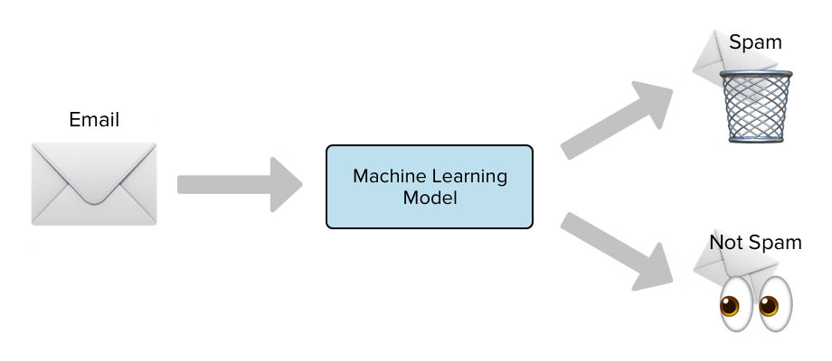
Problem Statement
overall_0_132335268282037724 columns_1_132225817802942803 2_1_132335268182249538
You are working in a data consulting company. Your client want you to build a spam detector so that employees get only relevant messages/email and it filters out all irrelevant/spam messages

Slide 3
Objective
overall_0_132335268282037724 columns_1_132225817802942803 2_1_132335268182249538
The SMS Spam Collection is a set of SMS tagged messages that have been collected for SMS Spam research. It contains one set of SMS messages in English of 5,574 messages, tagged according being ham (legitimate) or spam.
Your IT Team has already scraped all the messages in an excel file for you
The files contain one message per line.
Each line is composed of different message
You need to develop a spam detector so that whenever a new message hits inbox. The model should be able to guage whether it is a spam or an ham message

Slide 4

Agenda
overall_0_132335268282037724 columns_1_132225817802942803 2_1_132335268182249538
Step 1: Creation of training dataset
Step 2: Import Libraries
Step 3: Import Dataset
Step 4: Visualize Dataset
Step 5: Data cleaning
Remove Punctuation
Remove Stopwords
Count vectorizer
Step 6: Modelling
Step 7: Evaluate Performance

Slide 5
Agenda
overall_0_132335268282037724 columns_1_132225817802942803 2_1_132335268182249538
Step 1: Creation of training dataset
Step 2: Import Libraries
Step 3: Import Dataset
Step 4: Exploratory Data Analysis
Step 5: Univariate Analysis
Step 6: Data cleaning
Remove Punctuation
Remove Stopwords
Count vectorizer
Step 6: Modelling
Step 7: Evaluate Performance

Slide 6
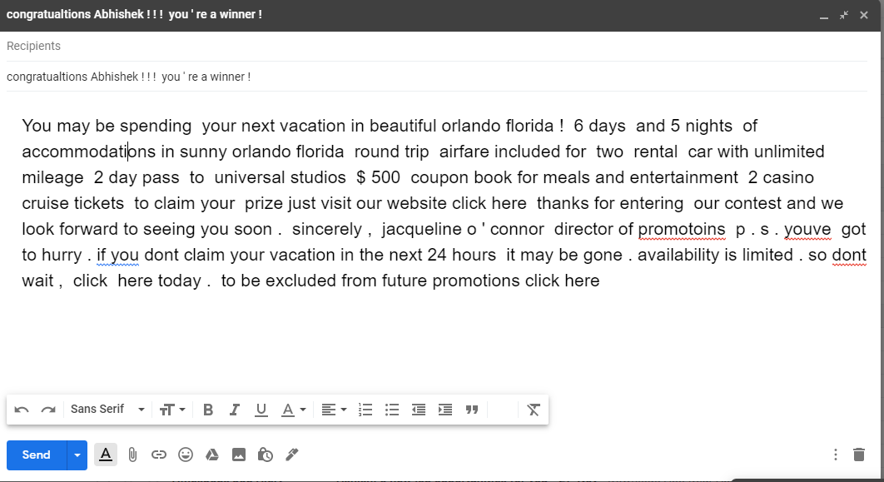
Step 1: Creation of training dataset
overall_0_132335268282037724 columns_1_132225817802942803 2_1_132335268182249538
A team of 3-4 analysts was created to perform manual classification on every message

Slide 7
Step 1: Creation of training dataset
overall_0_132335268282037724 columns_1_132225817802942803 2_1_132335268182249538
Example of spam message

Slide 8
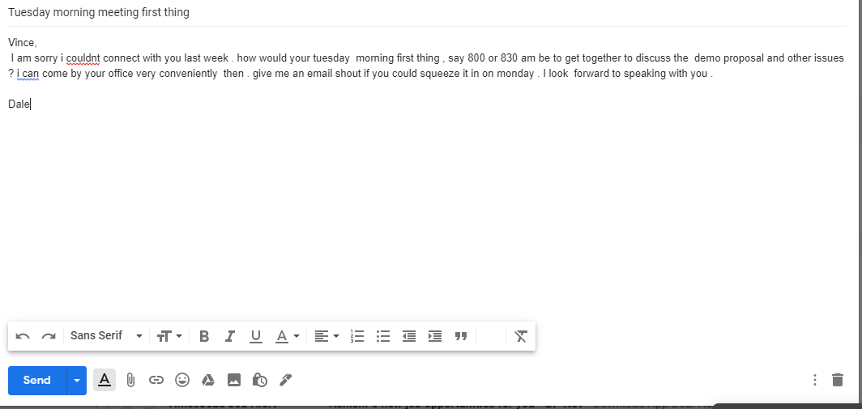
Step 1: Creation of training dataset
overall_0_132335268282037724 columns_1_132225817802942803 2_1_132335268182249538
Example of ham message

Slide 9
Agenda
overall_0_132335268282037724 columns_1_132225817802942803 2_1_132335268182249538
Step 1: Creation of training dataset
Step 2: Import Libraries
Step 3: Import Dataset
Step 4: Visualize Dataset
Step 5: Data cleaning
Remove Punctuation
Remove Stopwords
Count vectorizer
Step 6: Modelling
Step 7: Evaluate Performance

Slide 10
Step 2: Import Libraries
overall_0_132335268282037724 columns_1_132225817802942803 2_1_132335268182249538
Import Libraries
Pandas (Used for Table/Data Frame Manipulations)
Numpy (Used for Numerical Analysis)
Matlplotlib.pyplot (Used for Basic Visualization)
Seaborn (Used for Advanced Visualization)
Code:
import pandas as pd
import numpy as np
import matplotlib.pyplot as plt
import seaborn as sns

Slide 11
Agenda
overall_0_132335268282037724 columns_1_132225817802942803 2_1_132335268182249538
Step 1: Creation of training dataset
Step 2: Import Libraries
Step 3: Import Dataset
Step 4: Basic EDA
Step 5: Visualize Dataset
Step 6: Data cleaning
Remove Punctuation
Remove Stopwords
Count vectorizer
Step 7: Modelling
Step 8: Evaluate Performance

Slide 12
Step 3: Import Dataset
overall_0_132335268282037724 columns_1_132225817802942803 2_1_132335268182249538
Import Dataset (without encoding)
spam_df = pd.read_csv("emails.csv")

Slide 13
Agenda
overall_0_132335268282037724 columns_1_132225817802942803 2_1_132335268182249538
Step 1: Creation of training dataset
Step 2: Import Libraries
Step 3: Import Dataset
Step 4: Basic EDA
Step 5: Visualize Dataset
Step 6: Data cleaning
Remove Punctuation
Remove Stopwords
Count vectorizer
Step 7: Modelling
Step 8: Evaluate Performance

Slide 14
Step 4: Basic EDA
overall_0_132335268282037724 columns_1_132225817802942803 2_1_132335268182249538
spam_df.head(10): View top 10 rows
spam_df.tail(10): View bottom 10 rows
To get summary of the data
spam_df.describe()
spam_df.info()
Inference is there is no null values

Slide 15
Step 4: Basic EDA
overall_0_132335268282037724 columns_1_132225817802942803 2_1_132335268182249538
View legitimate data (i.e. ham data)
ham = spam_df[spam_df['spam']==0]
We have ~4300 ham rows in the dataset
View spam data (i.e. spam data)
spam = spam_df[spam_df['spam']==1]
spam
We have ~1400 ham rows in the dataset
View distribution of data
spam_df['spam'].value_counts()

Slide 16
Step 4: Basic EDA
overall_0_132335268282037724 columns_1_132225817802942803 2_1_132335268182249538
Print spam percentage (Exercise)
Print ham percentage (Exercise)

Slide 17
Agenda
overall_0_132335268282037724 columns_1_132225817802942803 2_1_132335268182249538
Step 1: Creation of training dataset
Step 2: Import Libraries
Step 3: Import Dataset
Step 4: Basic EDA
Step 5: Visualize Dataset
Step 6: Data cleaning
Remove Punctuation
Remove Stopwords
Count vectorizer
Step 7: Modelling
Step 8: Evaluate Performance

Slide 18
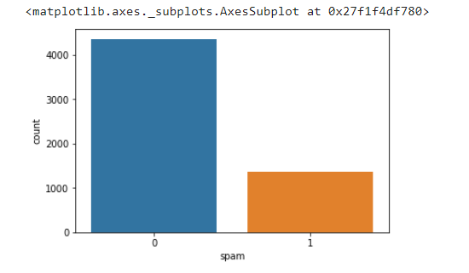
Step 5: Visualization (Spam vs ham)
overall_0_132335268282037724 columns_1_132225817802942803 2_1_132335268182249538
BIVARIATE Analysis
Bar chart
sns.countplot(spam_df['spam'], label = "Count")

Slide 19
Agenda
overall_0_132335268282037724 columns_1_132225817802942803 2_1_132335268182249538
Step 1: Creation of training dataset
Step 2: Import Libraries
Step 3: Import Dataset
Step 4: Basic EDA
Step 5: Visualize Dataset
Step 6: Data cleaning
Remove Punctuation
Remove Stopwords
Count vectorizer
Step 7: Modelling
Step 8: Evaluate Performance

Slide 20
Step 6: Data cleaning (Sample – for demo)
overall_0_132335268282037724 columns_1_132225817802942803 2_1_132335268182249538
BIVARIATE Analysis
Remove Punctuation
import string
string.punctuation
!"#$%&'()*+,-./:;<=>?@[\]^_`{|}~
Test = 'Hello Mr. Abhishek, I am so happy to be learning AI now!!‘

Slide 21
Step 6: Data cleaning (Sample – for demo)
overall_0_132335268282037724 columns_1_132225817802942803 2_1_132335268182249538
BIVARIATE Analysis
Remove Punctuation
Test = 'Hello Mr. Abhishek, I am so happy to be learning AI now!!‘
Using list comprehension
Test_punc_removed = [char for char in Test if char not in string.punctuation]
Without List comprehension
Test_punc_removed2 = []
for char in Test:
if char not in string.punctuation:
Test_punc_removed2.append(char)
Test_punc_removed2

Slide 22
Step 6: Data cleaning (Sample – for demo)
overall_0_132335268282037724 columns_1_132225817802942803 2_1_132335268182249538
BIVARIATE Analysis
Remove Stop words
import nltk
nltk.download('stopwords')
stopwords.words('english')
['i', 'me', 'my', 'myself', 'we', 'our', 'ours', 'ourselves', 'you', "you're", "you've", "you'll", "you'd", 'your', 'yours', 'yourself', 'yourselves', 'he', 'him', 'his', 'himself', 'she', "she's", 'her', 'hers', 'herself', 'it', "it's", 'its', 'itself', 'they', 'them', 'their', 'theirs', 'themselves', 'what', 'which', 'who', 'whom', 'this', 'that', "that'll", 'these', 'those', 'am', 'is', 'are', 'was', 'were', 'be', 'been', 'being', 'have', 'has', 'had', 'having', 'do', 'does', 'did', 'doing', 'a', 'an', 'the', 'and', 'but', 'if', 'or', 'because', 'as', 'until', 'while', 'of', 'at', 'by', 'for', 'with', 'about', 'against', 'between', 'into', 'through', 'during', 'before', 'after', 'above', 'below', 'to', 'from', 'up', 'down', 'in', 'out', 'on', 'off', 'over', 'under', 'again',

Slide 23
Step 6: Data cleaning (Sample – for demo)
overall_0_132335268282037724 columns_1_132225817802942803 2_1_132335268182249538
BIVARIATE Analysis
Remove Stop words
Test_punc_removed_join.split()
['Hello', 'Mr', 'Future', 'I', 'am', 'so', 'happy', 'to', 'be', 'learning', 'AI', 'now']
Test_punc_removed_join_clean = [word for word in Test_punc_removed_join.split() if word.lower() not in stopwords.words('english')]
Test_punc_removed_join_clean
['Hello', 'Mr', 'Future', 'happy', 'learning', 'AI']

Slide 24
Step 6: Data cleaning (Sample – for demo)
overall_0_132335268282037724 columns_1_132225817802942803 2_1_132335268182249538
BIVARIATE Analysis
Count Vectorizer
from sklearn.feature_extraction.text import CountVectorizer
sample_data = ['This is the first document.','This document is the second document.','And this is the third one.','Is this the first document?']
vectorizer = CountVectorizer()
X = vectorizer.fit_transform(sample_data)
print(vectorizer.get_feature_names())
['and', 'document', 'first', 'is', 'one', 'second', 'the', 'third', 'this']
print(X.toarray())
[[0 1 1 1 0 0 1 0 1]
[0 2 0 1 0 1 1 0 1]
[1 0 0 1 1 0 1 1 1]
[0 1 1 1 0 0 1 0 1]]

